Slide 1

Panther Fitness
Sign In
Sign Up
Notes:
Home Page

Slide 2
Panther Fitness
Sign In
Sign Up
Notes:
Home Page

Slide 3
Personal Information
Billing Information
First Name: Last Name: Email:
Password: Password confirm:
CC #: CVC: Billing Address:
CONTINUE
Notes:
Sign Up page

Slide 4

Membership Package
Sign Out
Select a membership package
Gold
INCLUDES
Cardio, Weights & Machines
Locker Rooms with Showers
Free Crunch One Kickoff
Online Nutrition Program
Power Half Hour Circuit Training
Gold $150/month
Silver 30$/month
Silver $80/month
Bronze $50/month
40 class pass $110
20 class pass $60
10 class pass $35
SUBMIT
Notes:
Sign Up Page (2) (choose membership Package)

Slide 5
Panther Fitness
Sign In
Sign Up

Slide 6
Panther Fitness
Email:
Password:
***********
Sign In
Notes:
Home Page

Slide 7

Access Denied
This terminal will be locked for 5 minutes
Notes:
Access denied

Slide 8


Welcome [Name],
Sign Out
CHECK IN
MY ACCOUNT
Notes:
Allowed Access → CHECK IN

Slide 9

Welcome [Name],
Sign Out
CHECK OUT
You checked-in at 12:31pm
MY ACCOUNT
Notes:
Allowed Access → CHECK OUT

Slide 10
Welcome [Name],
Sign Out
CHECK IN
MY ACCOUNT
Notes:
Allowed Access → MY ACCOUNT

Slide 11
Welcome [Name],
Sign Out
Add-Ons
Schedule Appointment
See my Progress
Notes:
Allowed Access → Customer main page

Slide 12
Welcome [Name],
Sign Out
Add-Ons
Schedule Appointment
See my Progress
Notes:
Customer main page

Slide 13
Welcome [Name],
Update Profile
Upgrade Membership
View Bill
Cancel Membership
Notes:
Click Icon and get scroll down

Slide 14
Welcome [Name],
Update Profile
Upgrade Membership
View Bill
Cancel Membership
Notes:
Click Icon and get scroll down

Slide 15
Personal Information
Billing Information
First Name: Last Name: Email:
Password: Password confirm:
CC #: CVC: Billing Address:
CONTINUE
Notes:
Update Profile page

Slide 16
Welcome [Name],
Update Profile
Upgrade Membership
View Bill
Cancel Membership
Notes:
Click Icon and get scroll down

Slide 17
Upgrade Membership
Sign Out
Select a membership package
Gold
INCLUDES
Cardio, Weights & Machines
Locker Rooms with Showers
Free Crunch One Kickoff
Online Nutrition Program
Power Half Hour Circuit Training
Gold $150/month
Silver $80/month
Bronze [NOW] $50/month
40 class pass $110
20 class pass $60
10 class pass $35
SUBMIT

Slide 18
Welcome [Name],
Update Profile
Upgrade Membership
View Bill
Cancel Membership
Notes:
Click Icon and get scroll down

Slide 19
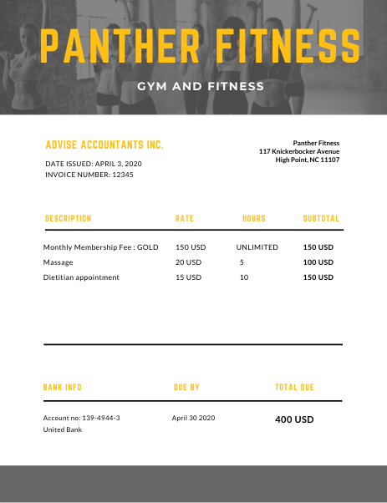
Monthly Bill
Notes:
View Bill

Slide 20
Welcome [Name],
Update Profile
Upgrade Membership
View Bill
Cancel Membership
Notes:
Click Icon and get scroll down

Slide 21

Cancel Membership
Are you sure you want to cancel your membership?
Yes, cancel
No, take me back
Notes:
Cancel Membership

Slide 22
Welcome [Name],
Sign Out
Add-Ons
Schedule Appointment
See my Progress
Notes:
Customer Main Page

Slide 23
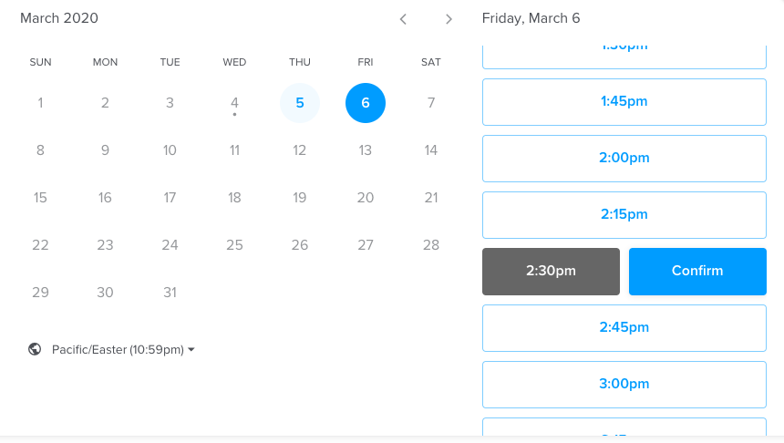
Add-Ons
Select Add-On...
1 hour Massage
Dietitian Appointment
Total: $20
Add to Monthly Fee
Pay Now

Slide 24
Pay for Add-On
Pay with credit card already entered
Gift Card:
Type Gift Card Number...
OR
Pay

Slide 25
Welcome [Name],
Customer main page
Sign Out
Add-Ons
Schedule Appointment
See my Progress

Slide 26
Schedule a Training Session
Select a Trainer...
Michael J. Whittaker
Willie S. Ernst
Daniel T. Jackson
George G. Frantz
Schedule

Slide 27
Welcome [Name],
Customer main page
Sign Out
Add-Ons
Schedule Appointment
See my Progress

Slide 28
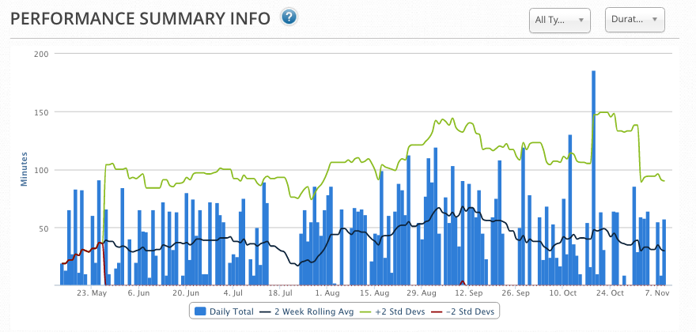
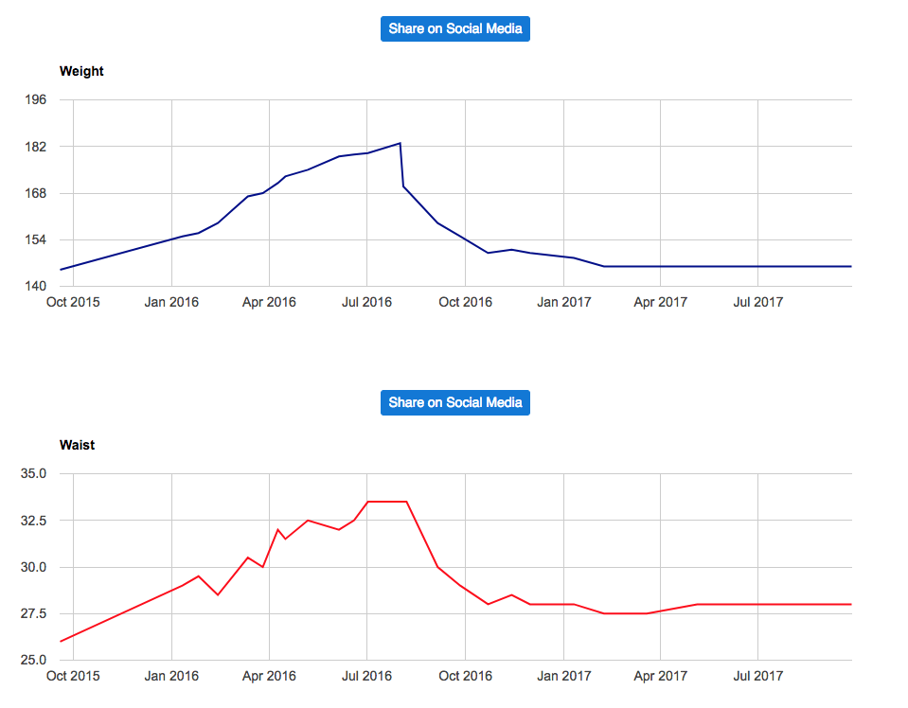
My Progress
WEIGHT: 148.9 lbs. (– 1.0 lbs.)
BODYFAT: 11.9% (+ 1.0%)
FAT-MASS: 17.61 (+ 1.60)
FAT-FREE MUSCLE: 129.61 (– 1.20)
NECK: 14.25″ (+/- 0″)
CHEST: 37.25″ (– .25″)
SHOULDERS: 45″ (+ .5″)
RIGHT ARM: 12.5″ (+ .25″)
HIPS: 31″ (+/- 0″)
WAIST: 29″ (+/- 0″)
RIGHT CALF: 13.25″ (+/- 0″)
RIGHT THIGH: 20.5″ (+ .25″)
My Weight My Waist
Notes:
View progress (customer

Slide 29
Welcome [Name],
Sign Out
View Customer Progress
Update Customer Progress
View Schedule
Notes:
Trainer main page

Slide 30
Welcome [Name],
Sign Out
View Customer Progress
Update Customer Progress
View Schedule
Notes:
Trainer main page

Slide 31

View Customer Progress
Michael
WEIGHT: 148.9 lbs. (– 1.0 lbs.)
BODYFAT: 11.9% (+ 1.0%)
FAT-MASS: 17.61 (+ 1.60)
FAT-FREE MUSCLE: 129.61 (– 1.20)
NECK: 14.25″ (+/- 0″)
CHEST: 37.25″ (– .25″)
SHOULDERS: 45″ (+ .5″)
RIGHT ARM: 12.5″ (+ .25″)
HIPS: 31″ (+/- 0″)
WAIST: 29″ (+/- 0″)
RIGHT CALF: 13.25″ (+/- 0″)
RIGHT THIGH: 20.5″ (+ .25″)
Michael Hoppe
Michael Lawrence
Michael Wilkinson

Slide 32
Welcome [Name],
Trainer main page
Sign Out
View Customer Progress
Update Customer Progress
View Schedule

Slide 33
Update Customer Progress
Michael
Michael Hoppe
Date: Weight:
.. / .. / ….
LBS
Michael Lawrence
Michael Wilkinson
Update
Weight
Waist
BMI
CANCEL
CONFIRM

Slide 34
Welcome [Name],
Trainer main page
Sign Out
View Customer Progress
Update Customer Progress
View Schedule

Slide 35
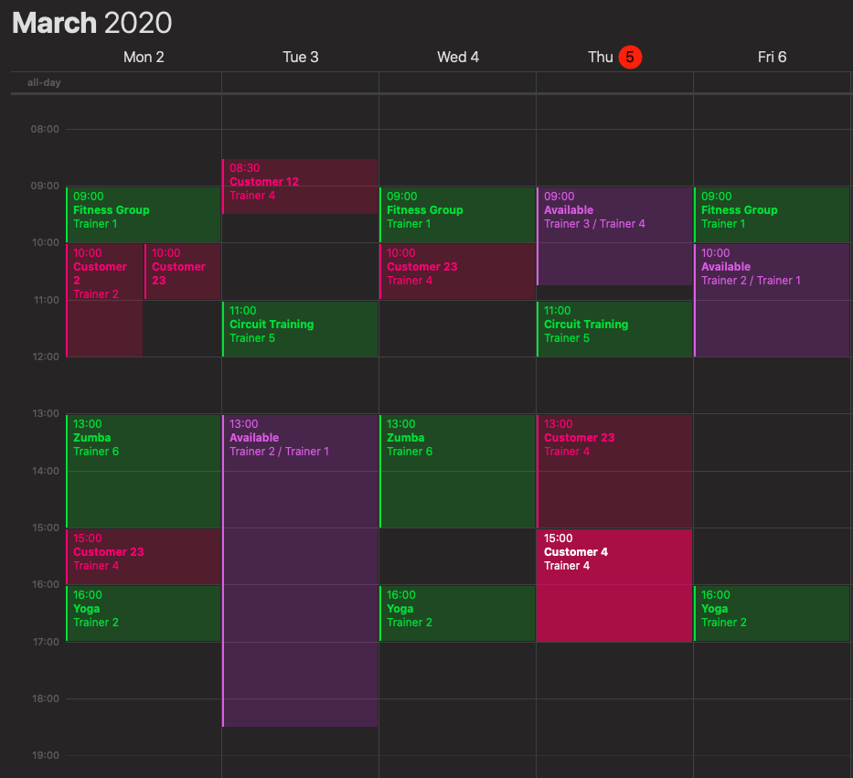
View Weekly Schedule

Slide 36
Welcome [Name],
Manager main page
Sign Out
Manage Shift
Generate Reports
View Progress
Update Progress
Schedule
Add / Remove Employee

Slide 37
Manage Shift
Job
Employee
Trainer
Michael Hoppe
Massage Therapist
Michael Lawrence
Dietitian
Michael Wilkinson
Date : From : To:
../../….
Add
Remove
Submit

Slide 38
Welcome [Name],
Manager main page
Sign Out
Manage Shift
Generate Reports
View Progress
Update Progress
Schedule
Add / Remove Employee

Slide 39
Generate Report
Select Report...
Revenue Report
Revenues
Services
Busiest Days
Print

Slide 40
Welcome [Name],
Sign Out
Manage Shift
Generate Reports
View Progress
Update Progress
Schedule
Add / Remove Employee
Notes:
Manager main page

Slide 41
View Customer Progress
Michael
WEIGHT: 148.9 lbs. (– 1.0 lbs.)
BODYFAT: 11.9% (+ 1.0%)
FAT-MASS: 17.61 (+ 1.60)
FAT-FREE MUSCLE: 129.61 (– 1.20)
NECK: 14.25″ (+/- 0″)
CHEST: 37.25″ (– .25″)
SHOULDERS: 45″ (+ .5″)
RIGHT ARM: 12.5″ (+ .25″)
HIPS: 31″ (+/- 0″)
WAIST: 29″ (+/- 0″)
RIGHT CALF: 13.25″ (+/- 0″)
RIGHT THIGH: 20.5″ (+ .25″)
Michael Hoppe
Michael Lawrence
Michael Wilkinson

Slide 42
Welcome [Name],
Manager main page
Sign Out
Manage Shift
Generate Reports
View Progress
Update Progress
Schedule
Add / Remove Employee

Slide 43
Update Customer Progress
Michael
Michael Hoppe
Date: Weight:
.. / .. / ….
LBS
Michael Lawrence
Michael Wilkinson
Update
Weight
Waist
BMI
CANCEL
CONFIRM
Notes:
Update Customer Progress

Slide 44
Welcome [Name],
Manager main page
Sign Out
Manage Shift
Generate Reports
View Progress
Update Progress
Schedule
Add / Remove Employee

Slide 45
View Weekly Schedule
Schedule
Trainers
Massage Therapists
Dietitians

Slide 46
Welcome [Name],
Manager main page
Sign Out
Manage Shift
Generate Reports
View Progress
Update Progress
Schedule
Add / Remove Employee

Slide 47
Add/Remove Employee
Employee email adress :
Name:
Title :
Add
Remove

Slide 48
Welcome [Name],
Sign Out
View Progress
Update Progress
View Schedule
Notes:
Dietitian main page

Slide 49
View Customer Progress
Michael
WEIGHT: 148.9 lbs. (– 1.0 lbs.)
BODYFAT: 11.9% (+ 1.0%)
FAT-MASS: 17.61 (+ 1.60)
FAT-FREE MUSCLE: 129.61 (– 1.20)
NECK: 14.25″ (+/- 0″)
CHEST: 37.25″ (– .25″)
SHOULDERS: 45″ (+ .5″)
RIGHT ARM: 12.5″ (+ .25″)
HIPS: 31″ (+/- 0″)
WAIST: 29″ (+/- 0″)
RIGHT CALF: 13.25″ (+/- 0″)
RIGHT THIGH: 20.5″ (+ .25″)
Michael Hoppe
Michael Lawrence
Michael Wilkinson
Notes:
Dietitian View Customer Progress

Slide 50
Welcome [Name],
Dietitian main page
Sign Out
View Progress
Update Progress
View Schedule

Slide 51
Update Customer Progress
Michael
Michael Hoppe
Date: Weight:
.. / .. / ….
LBS
Michael Lawrence
Michael Wilkinson
Update
Weight
Waist
BMI
CANCEL
CONFIRM
Notes:
Update Customer Progress

Slide 52
Welcome [Name],
Dietitian main page
Sign Out
View Progress
Update Progress
View Schedule

Slide 53
View Weekly Schedule
Dietitian can only see Dietitian Schedule

Slide 54
Welcome [Name],
Massage Therapist main page
Sign Out
View Schedule

Slide 55
View Weekly Schedule
Massage Therapist can only see his schedule

